Slide 1
Transformers in Computer Vision
Sergey Zagoruyko October 6, 2024

Slide 2
Course contents:
Transformers in Computer Vision
Transformers in Object Detection
Transformers in Autonomous Driving

Slide 3
What is convolution?

Slide 4
Convolution Example
Input:
Filter: Output:
1 | 4 | −1 | 0 | 2 | −2 | 1 | 3 | 3 | 1
1 | 2 | 0 | −1
Source: François Fleuret’s deep learning course
4 / 38

Slide 5
Convolution Example
Input:
Filter: Output:
1 | 4 | −1 | 0 | 2 | −2 | 1 | 3 | 3 | 1
1 | 2 | 0 | −1
9
Source: François Fleuret’s deep learning course
4 / 38

Slide 6
Convolution Example
Input:
Filter: Output:
1 | 4 | −1 | 0 | 2 | −2 | 1 | 3 | 3 | 1
1 | 2 | 0 | −1
9 | 0
Source: François Fleuret’s deep learning course
4 / 38

Slide 7
Convolution Example
Input:
Filter: Output:
1 | 4 | −1 | 0 | 2 | −2 | 1 | 3 | 3 | 1
1 | 2 | 0 | −1
9 | 0 | 1
Source: François Fleuret’s deep learning course
4 / 38

Slide 8
Convolution Example
Input:
Filter: Output:
1 | 4 | −1 | 0 | 2 | −2 | 1 | 3 | 3 | 1
1 | 2 | 0 | −1
9 | 0 | 1 | 3
Source: François Fleuret’s deep learning course
4 / 38

Slide 9
Convolution Example
Input:
Filter: Output:
1 | 4 | −1 | 0 | 2 | −2 | 1 | 3 | 3 | 1
1 | 2 | 0 | −1
9 | 0 | 1 | 3 | −5
Source: François Fleuret’s deep learning course
4 / 38

Slide 10
Convolution Example
Input:
Filter: Output:
1 | 4 | −1 | 0 | 2 | −2 | 1 | 3 | 3 | 1
1 | 2 | 0 | −1
9 | 0 | 1 | 3 | −5 | −3
Source: François Fleuret’s deep learning course
4 / 38

Slide 11
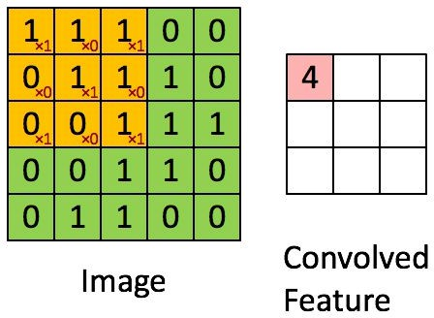
Convolutions in 2D

Slide 12
LeNet
LeNet-5 in 1998
https://en.wikipedia.org/wiki/LeNet

Slide 13
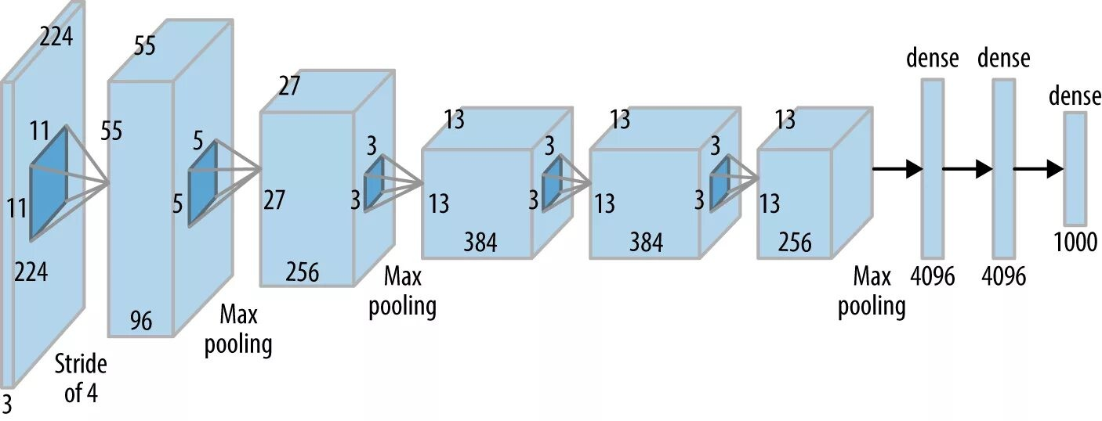
AlexNet
AlexNet in 2012
https://machinelearningmastery.ru/the-w3h-of-alexnet-vggnet-resnet-and-inception-7baaaecccc96/

Slide 14
Inductive Bias in Neural Networks
Definition:
Inductive bias refers to the set of assumptions a learning algorithm makes to generalize from the training data to unseen data.
8 / 38

Slide 15
Inductive Bias in Neural Networks
Definition:
Inductive bias refers to the set of assumptions a learning algorithm makes to generalize from the training data to unseen data.
Importance:
Helps in guiding the learning process and making predictions.
Determines the types of patterns a model can learn.
8 / 38

Slide 16
Inductive Bias in Neural Networks
Definition:
Inductive bias refers to the set of assumptions a learning algorithm makes to generalize from the training data to unseen data.
Importance:
Helps in guiding the learning process and making predictions.
Determines the types of patterns a model can learn.
Examples in Neural Networks:
Convolutional Neural Networks (CNNs): Assumption of spatial hierarchies in images.
Recurrent Neural Networks (RNNs): Assumption of sequential dependencies in time-series data.
8 / 38

Slide 17
Inductive Bias in Neural Networks
Definition:
Inductive bias refers to the set of assumptions a learning algorithm makes to generalize from the training data to unseen data.
Importance:
Helps in guiding the learning process and making predictions.
Determines the types of patterns a model can learn.
Examples in Neural Networks:
Convolutional Neural Networks (CNNs): Assumption of spatial hierarchies in images.
Recurrent Neural Networks (RNNs): Assumption of sequential dependencies in time-series data.
Trade-offs:
Stronger biases can lead to faster learning but may reduce flexibility.
Weaker biases increase flexibility but may require more data.
8 / 38

Slide 18
Two pillars of deep learning:
9 / 38

Slide 19
Two pillars of deep learning:
Large amounts of rich diverse data
9 / 38

Slide 20
Two pillars of deep learning:
Large amounts of rich diverse data
Large amounts of compute
9 / 38

Slide 21
AlexNet
Visualizing parameters
Francois Fleuret’s Deep Learning Course

Slide 22
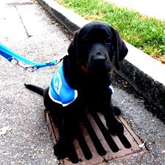
AlexNet
Visualizing activations
Francois Fleuret’s Deep Learning Course
11 / 38

Slide 23
AlexNet
Visualizing activations
Francois Fleuret’s Deep Learning Course
11 / 38

Slide 24
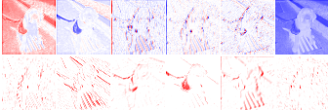
AlexNet
Visualizing activations
Francois Fleuret’s Deep Learning Course

Slide 25
AlexNet
Visualizing activations

Slide 26
AlexNet
Visualizing activations

Slide 27
AlexNet
Visualizing activations

Slide 28
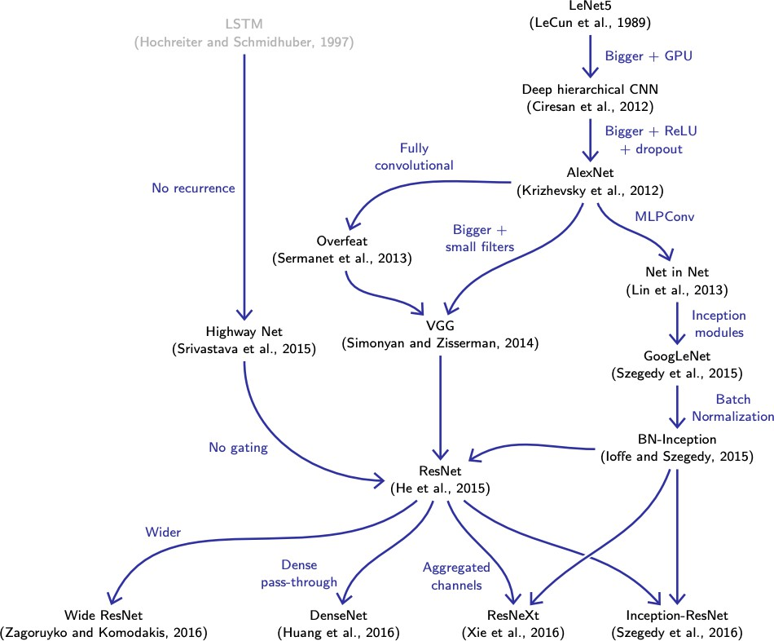
AlexNet

Slide 29
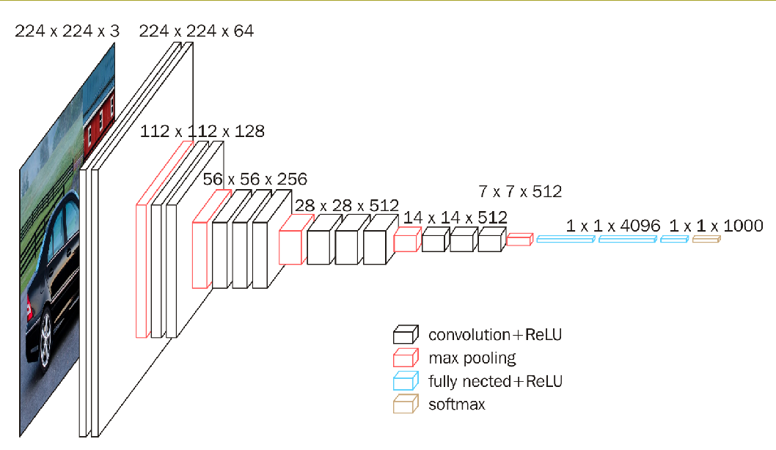
VGG

Slide 30
ResNet
x_{l}
x_{l}
conv1x1
conv3x3
conv3x3
conv3x3
conv1x1
^{x}l+1
^{x}l+1
(Zagoruyko and Komodakis 2016)

Slide 31
What is a Transformer?

Slide 32
Self-attention
Core operation in the Transformer:
Q = W_{q} X K = W_{k} X V = W_{v} X
QK^{T}
Z = softmax( √_{d} )V
20 / 38

Slide 33
Self-attention
Core operation in the Transformer:
Q = W_{q} X K = W_{k} X V = W_{v} X
QK^{T}
Z = softmax( √_{d} )V
Quadratic cost
Input order equivariant
20 / 38

Slide 34
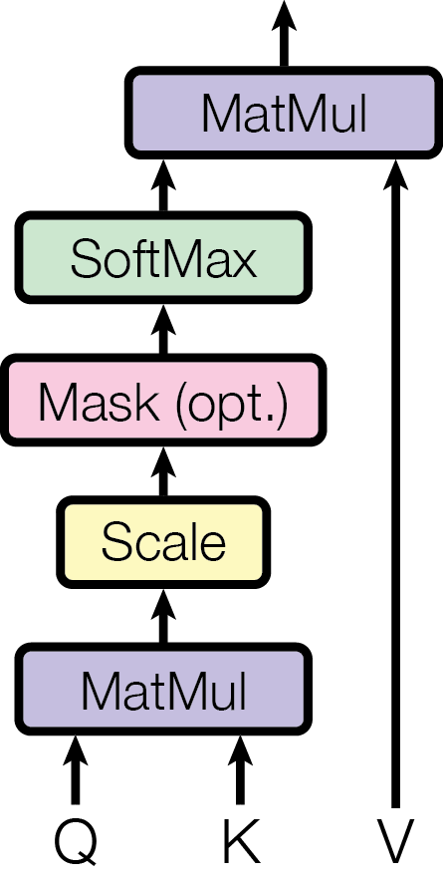
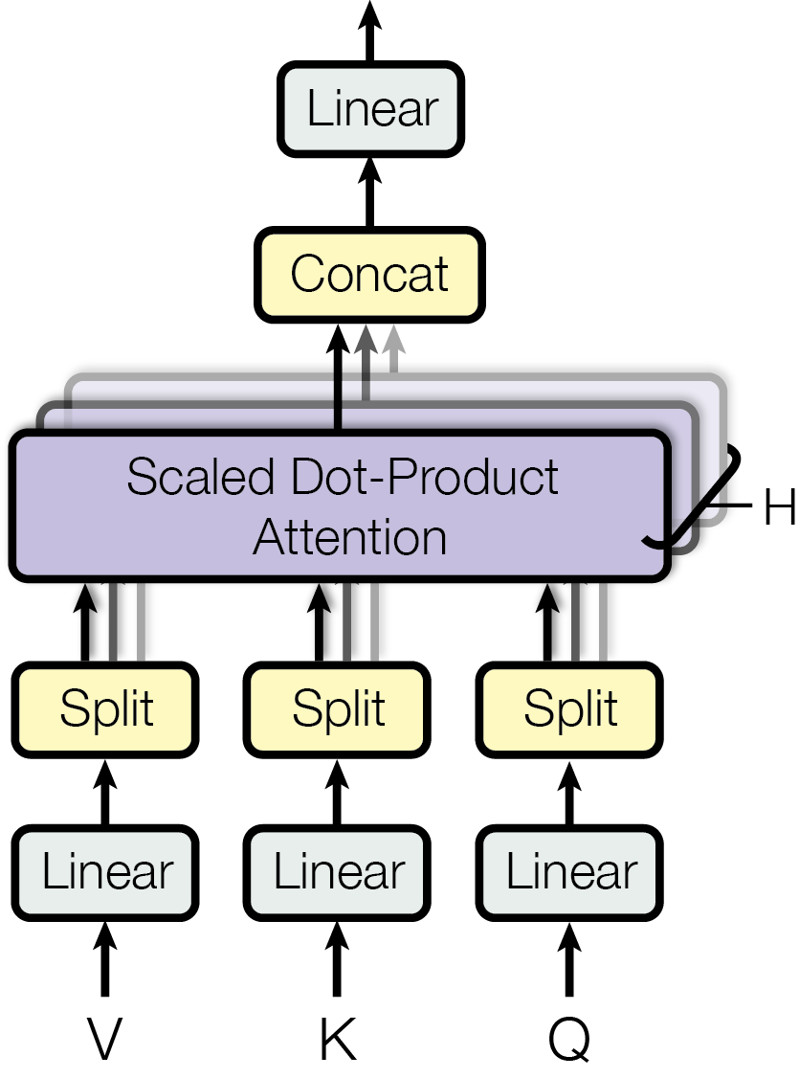
Multi-head attention
Scaled Dot-Product Attention
Multi-head Attention
QK^{T}
Attention(Q, K, V ) = softmax( √_{dk} )V
MultiHead(Q, K, V ) = Concat(H₁, ..., H_{h} )W^{O}
H_{i} = Attention(QW^{Q}, KW^{K}, VW^{V} ), i = 1, ..., h
i i i
Q
d
×d K
d ×d V
d ×d O
hd ×d
W ∈ R
model k
, W ∈ R
model k
, W ∈ R
model v
, W ∈ R
v model
i
i
i
i

Slide 35
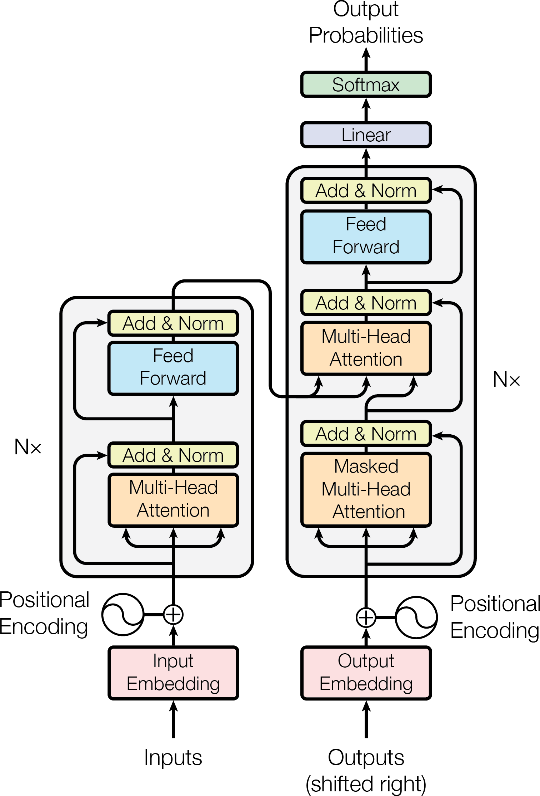
Original Transformer (Vaswani et al. 2017)

Slide 36
Seq2Seq Translation: Apple to Pomme
Encoder
a
p
p
l
e
p
o
m
m
e

Slide 37
ViT: Vision Transformers
Vision Transformer,
.
ViT (Dosovitskiy et al. 2020) -
Inspired by the Transformer scaling successes in NLP, we experiment with applying a standard Transformer directly to images, with the fewest possible modifications. To do so, we split an image into patches and provide the se- quence of linear embeddings of these patches as an input to a Transformer. Image patches are treated the same way as tokens (words) in an NLP ap- plication. We train the model on image classification in supervised fashion. (Dosovitskiy et al. 2020)

Slide 38
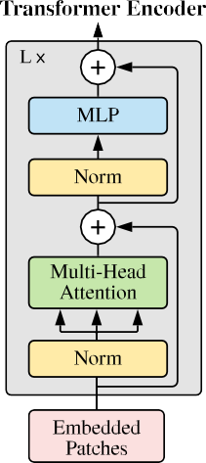
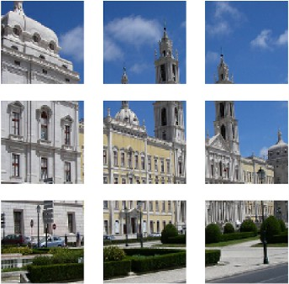
ViT: Vision Transformers
(Dosovitskiy et al. 2020)

Slide 39
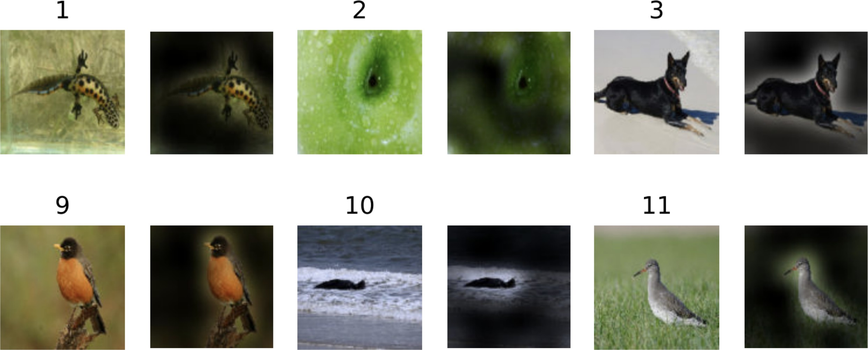
ViT attention

Slide 40
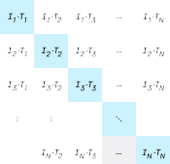
What is CLIP?
CLIP stands for Contrastive Language–Image Pretraining.
Developed by OpenAI, it combines text and image understanding.
Utilizes a large dataset of text-image pairs for training.
https://openai.com/index/clip

Slide 41
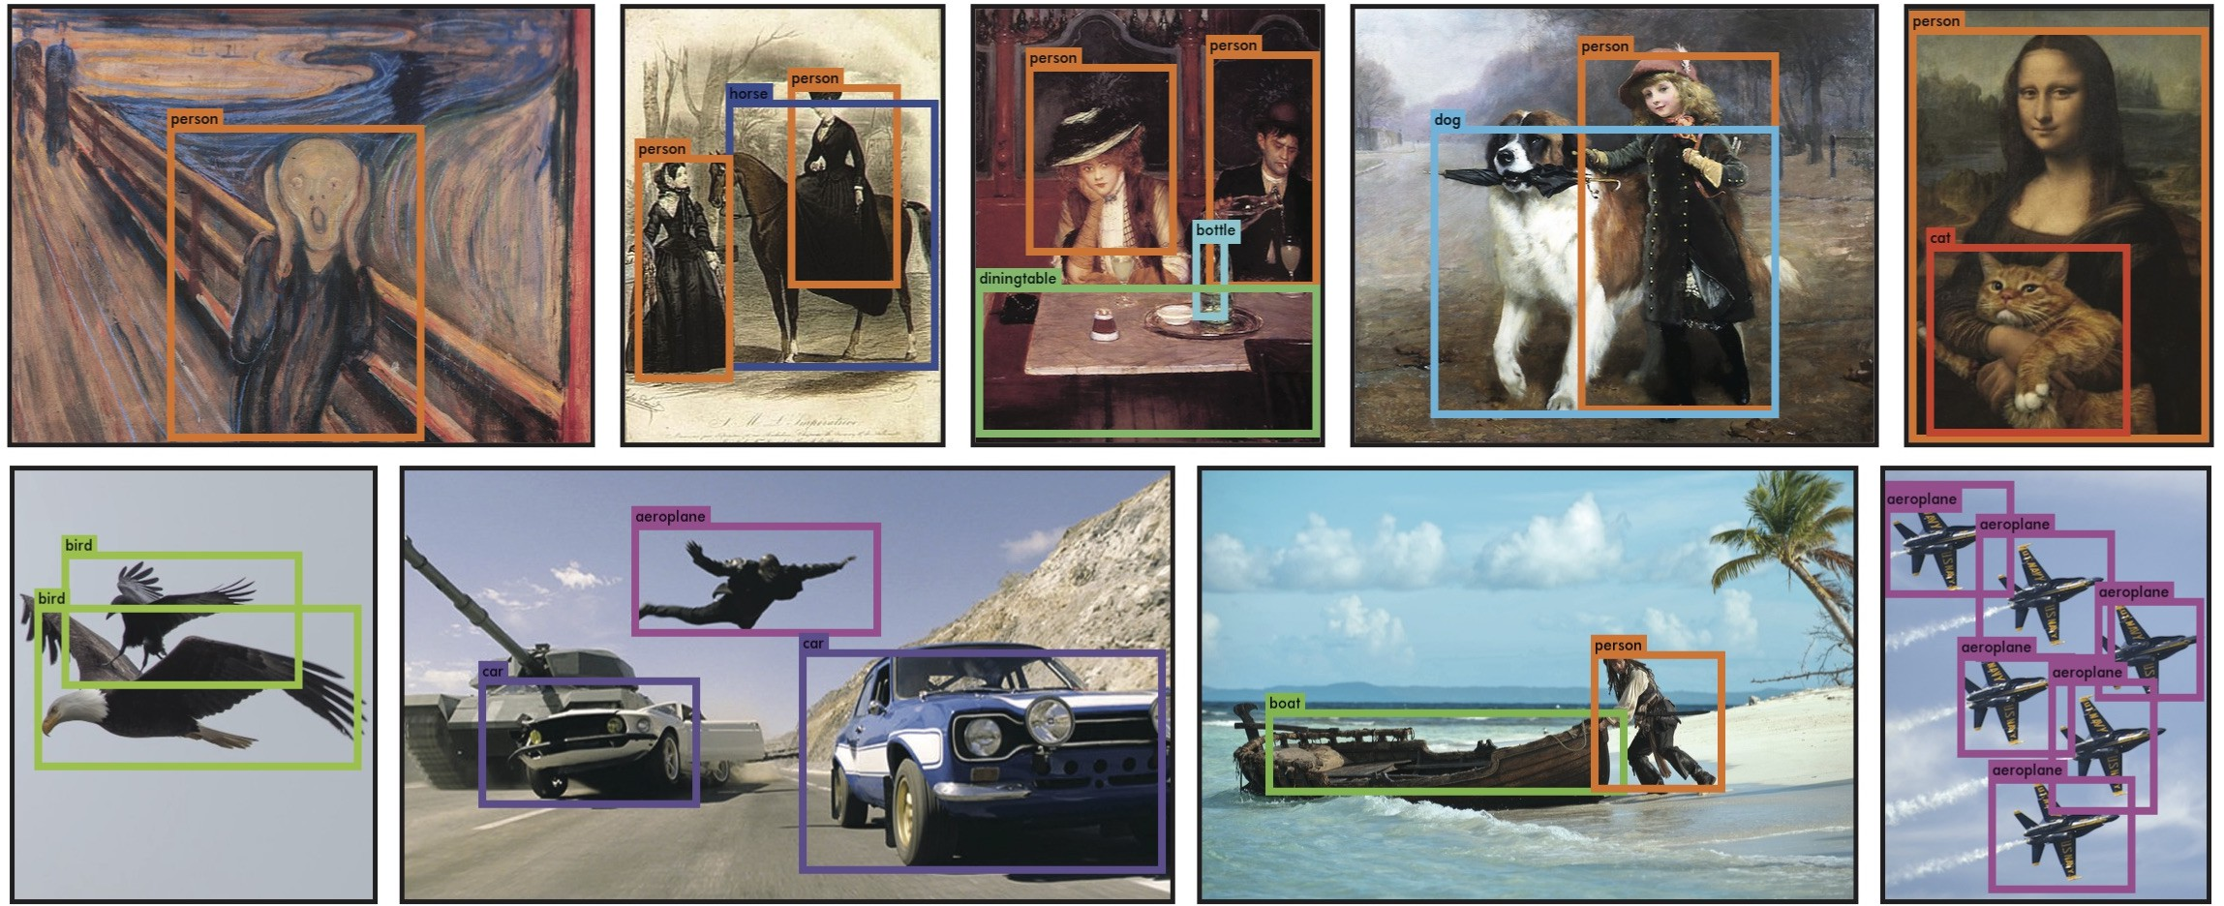
Object Detection
Object Detection

Slide 42
Object Detection
80
FocalNet-H (DINO) ^{Co-DETR} DyHead (Swin-L, multi scale, self-training)
DetectoRS (ResNeXt-101-64x4d, multi-scale)
60
NAS-FPN (AmoebaNet-D, learned aug) D-RFCN + SNIP (DPN-98 with ﬂip, multi-scale)
Mask R-CNN (ResNeXt-101-FPN)
BOX MAP
40
Faster R-CNN (box reﬁnement, context, multi-scale testing) SSD512
20
Fast-RCNN
0
2016
2018
2020 2022
Models with highest box mAP
2024
Other models
https://paperswithcode.com/sota/object-detection-on-coco

Slide 43
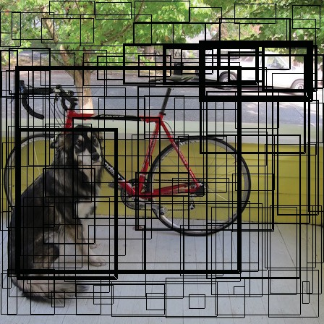
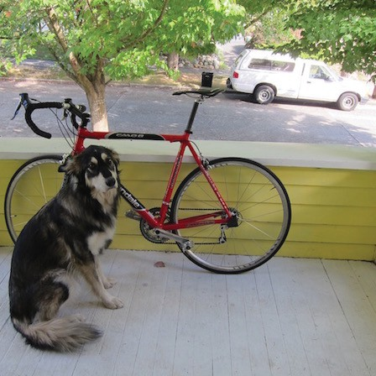
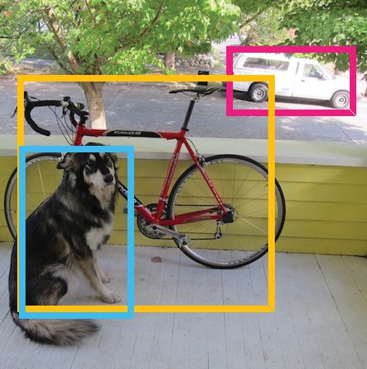
YOLO
Bounding boxes + confidence
S × S grid on input
Final detections
Class probability map

Slide 44
Classical approach to detection
Popular approach: detection := classification of boxes
31 / 38

Slide 45
Classical approach to detection
Popular approach: detection := classification of boxes
Requires selecting a subset of candidate boxes
31 / 38

Slide 46
Classical approach to detection
Popular approach: detection := classification of boxes
Requires selecting a subset of candidate boxes
Regression step to refine the predictions
31 / 38

Slide 47
Classical approach to detection
Popular approach: detection := classification of boxes
Requires selecting a subset of candidate boxes
Regression step to refine the predictions
Typically non-differentiable
31 / 38

Slide 48
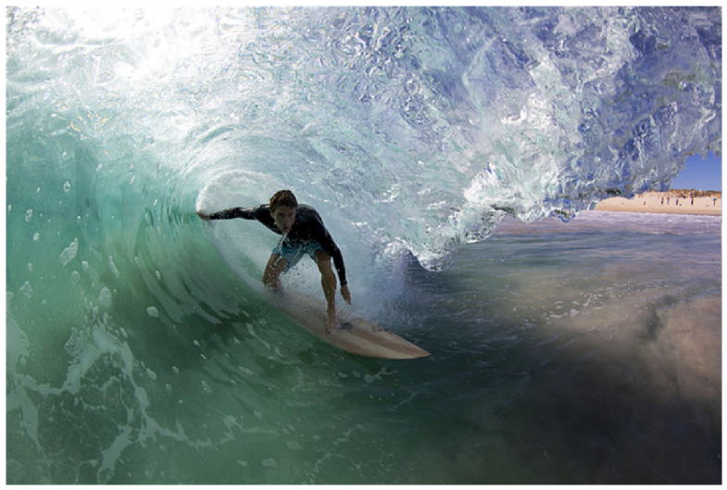
DETR: Rethinking object detection
Neural machine translation from features to boxes
transformer encoder-decoder
CNN
set of image features
set of box predictions
32 / 38

Slide 49
DETR: Rethinking object detection
Neural machine translation from features to boxes
transformer encoder-decoder
CNN
set of image features
End-to-end parallel set prediction
set of box predictions
32 / 38

Slide 50
DETR: Rethinking object detection
Neural machine translation from features to boxes
transformer encoder-decoder
CNN
set of image features
End-to-end parallel set prediction
Global scene reasoning
set of box predictions
32 / 38

Slide 51
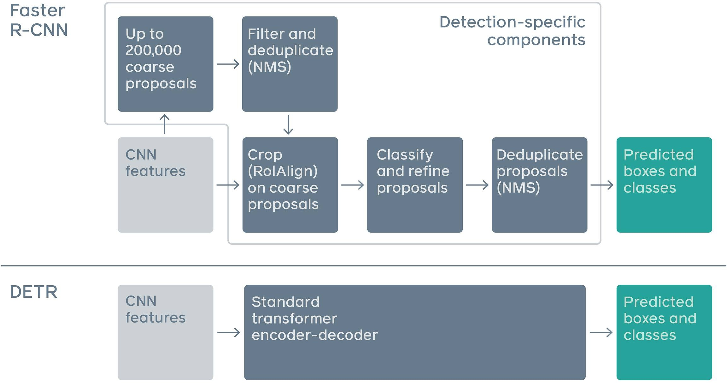
Streamlined detection pipeline

Slide 52
We use standard ResNet from torchvision
Backbone
Encoder
Decoder
Heads
CNN
• • •
FFN
class,
bbox
transformer encoder
transformer decoder
FFN |  | no object
+
FFN
class,
bbox
• • •
FFN |  | no object
positional encoding
34 / 38

Slide 53
We use standard ResNet from torchvision
Pretraining on Imagenet is key (labels or SSL)
Backbone
Encoder
Decoder
Heads
CNN
• • •
FFN
class,
bbox
transformer encoder
transformer decoder
FFN |  | no object
+
FFN
class,
bbox
• • •
FFN |  | no object
positional encoding
34 / 38

Slide 54
We use 2D sine/cosine embeddings
Backbone
CNN
Encoder
Decoder
Heads
• • •
FFN
class,
bbox
transformer encoder
FFN
no
+
transformer decoder
object
FFN
class,
bbox
FFN
no
• • •
object
positional encoding
34 / 38

Slide 55
We use 2D sine/cosine embeddings
Embeddings are added to features
Backbone
Encoder
Decoder
Heads
CNN
• • •
FFN
class,
bbox
transformer encoder
transformer decoder
FFN |  | no object
+
FFN
class,
bbox
• • •
FFN |  | no object
positional encoding
34 / 38

Slide 56
We use 6 layers of transformer encoder
Backbone
Encoder
Decoder
Heads
CNN
• • •
FFN
class,
bbox
transformer encoder
transformer decoder
FFN |  | no object
+
FFN
class,
bbox
• • •
FFN |  | no object
positional encoding
34 / 38

Slide 57
We use 6 layers of transformer encoder
Global reasoning through attention
Backbone
Encoder
Decoder
Heads
CNN
• • •
FFN
class,
bbox
transformer encoder
transformer decoder
FFN |  | no object
+
FFN
class,
bbox
• • •
FFN |  | no object
positional encoding
34 / 38

Slide 58
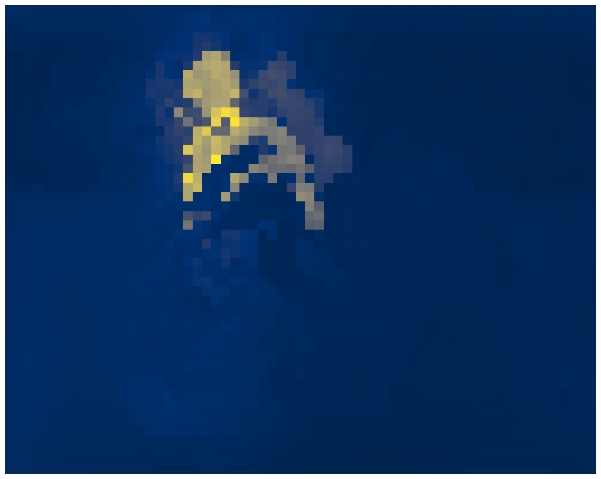
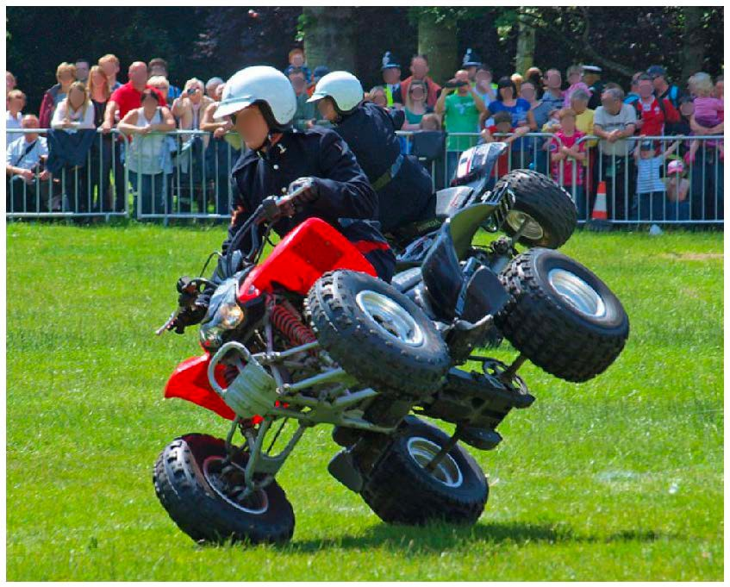
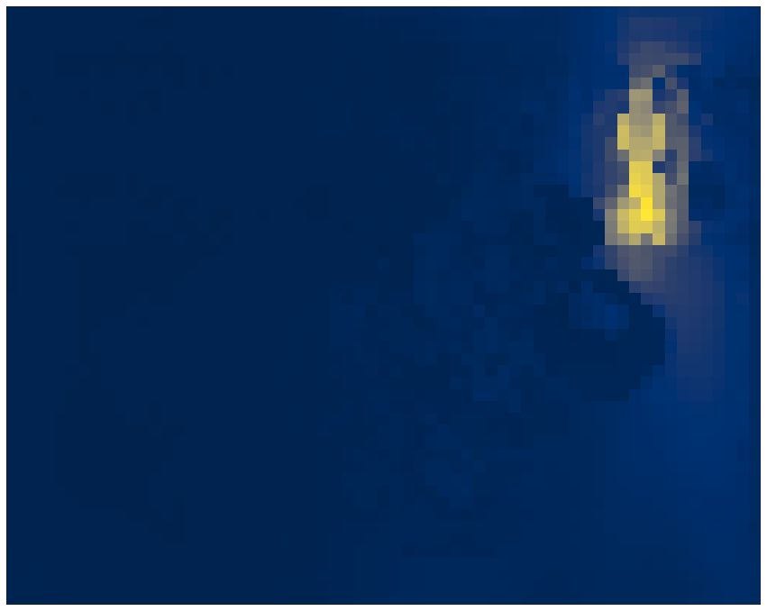
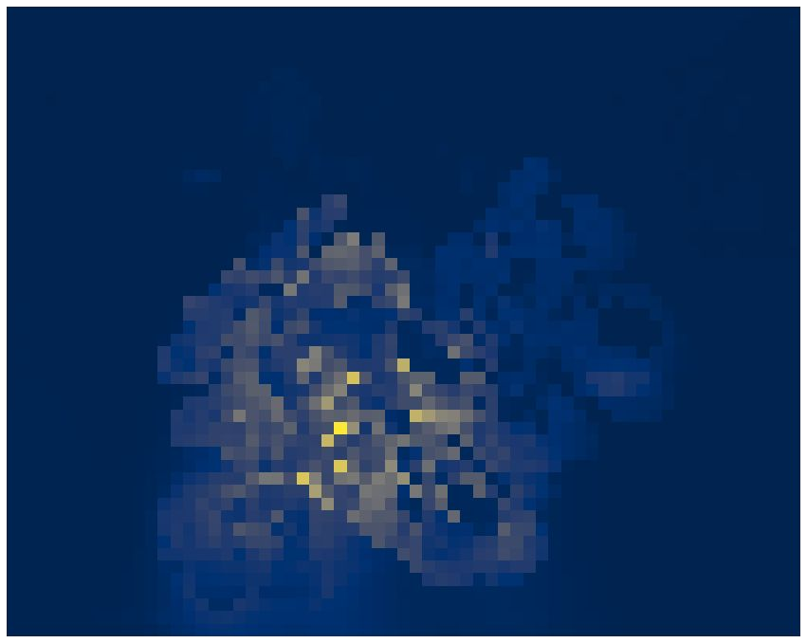
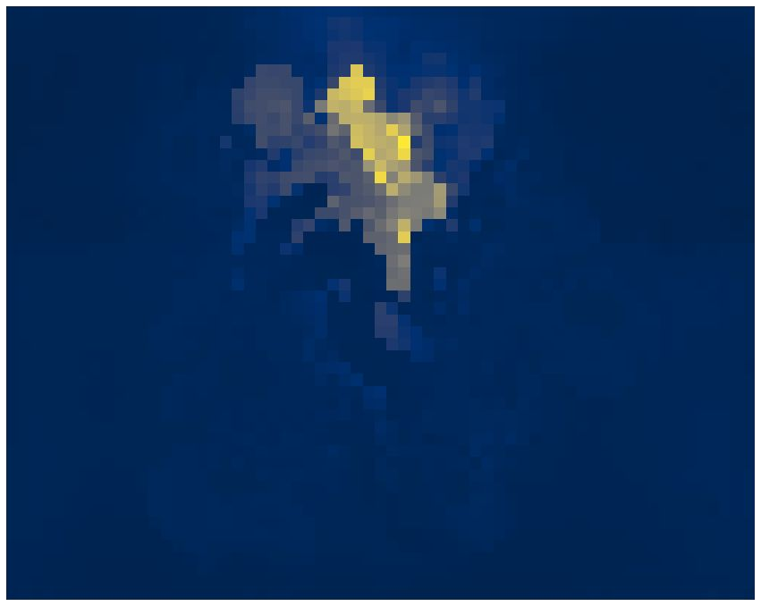
We use 6 layers of transformer encoder
Global reasoning through attention
Starts separating instances
Attention(220, 350)
Attention(500, 400)
Attention(150, 850)
Attention(220, 530) ;
Backbone
Encoder
Decoder
Heads
CNN
• • •
FFN
class,
bbox
transformer encoder
transformer decoder
FFN |  | no object
+
FFN
class,
bbox
• • •
FFN |  | no object
positional encoding
34 / 38

Slide 59
We use 6 layers of transformer decoder;
Backbone
Encoder
Decoder
Heads
CNN
• • •
FFN
class,
bbox
transformer encoder
transformer decoder
FFN |  | no object
+
FFN
class,
bbox
• • •
FFN |  | no object
positional encoding
34 / 38

Slide 60
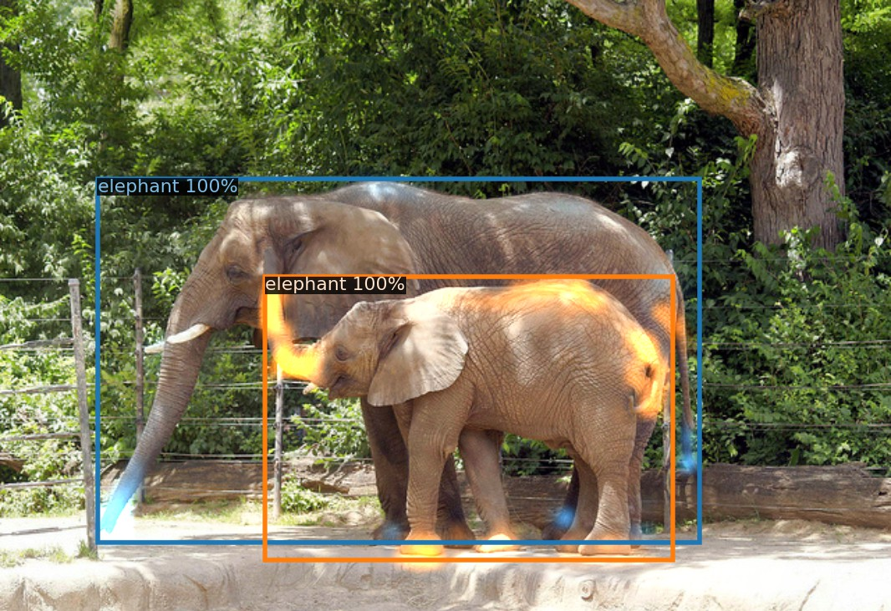
We use 6 layers of transformer decoder;
Attention focuses on extremities
;
Backbone
Encoder
Decoder
Heads
CNN
• • •
FFN
class,
bbox
transformer encoder
transformer decoder
FFN |  | no object
+
FFN
class,
bbox
• • •
FFN |  | no object
positional encoding
34 / 38

Slide 61
We use 6 layers of transformer decoder;
Attention focuses on extremities
Predictions are refined at each layer
in parallel
;
Backbone
Encoder
Decoder
Heads
CNN
• • •
FFN
class,
bbox
transformer encoder
transformer decoder
FFN |  | no object
+
FFN
class,
bbox
• • •
FFN |  | no object
positional encoding
34 / 38

Slide 62
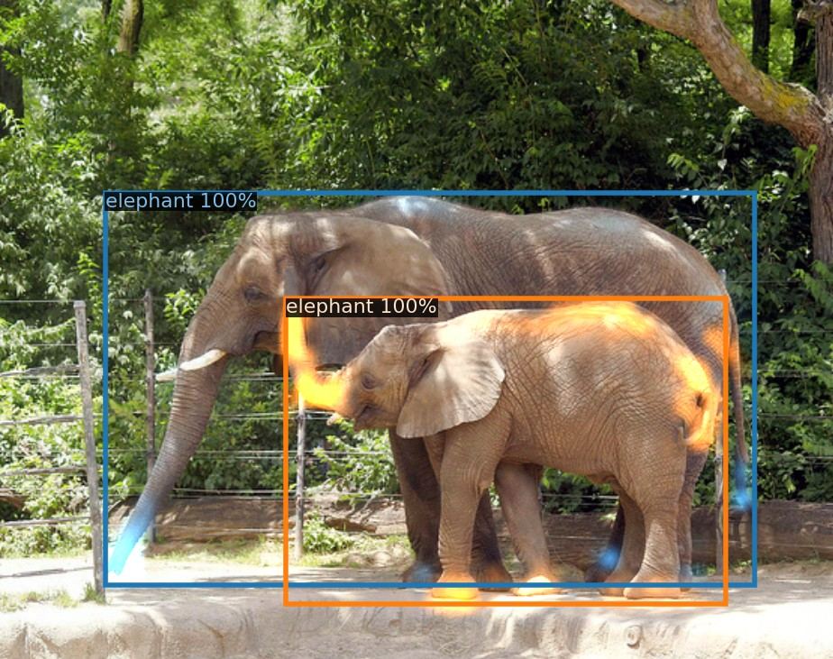
Decoder attention weights
6 decoder layers of:
self-attention
enc-dec attention
FFN
LayerNorm
All outputs are decoded in parallel
Attention focuses on extremities

Slide 63
Decoder: no NMS needed
62
60
58
56
54
42
AP/AP₅₀ goes up in lower layers (no communication)
AP goes down in the last layers
AP₅₀ goes up slightly
There is no need for NMS in DETR
40
AP
AP₅₀
38
AP No NMS AP NMS=0.7 AP50 No NMS AP50 NMS=0.7
36
AP No NMS AP NMS=0.7
34
1
2
3 4
decoder layer
5
6

Slide 64
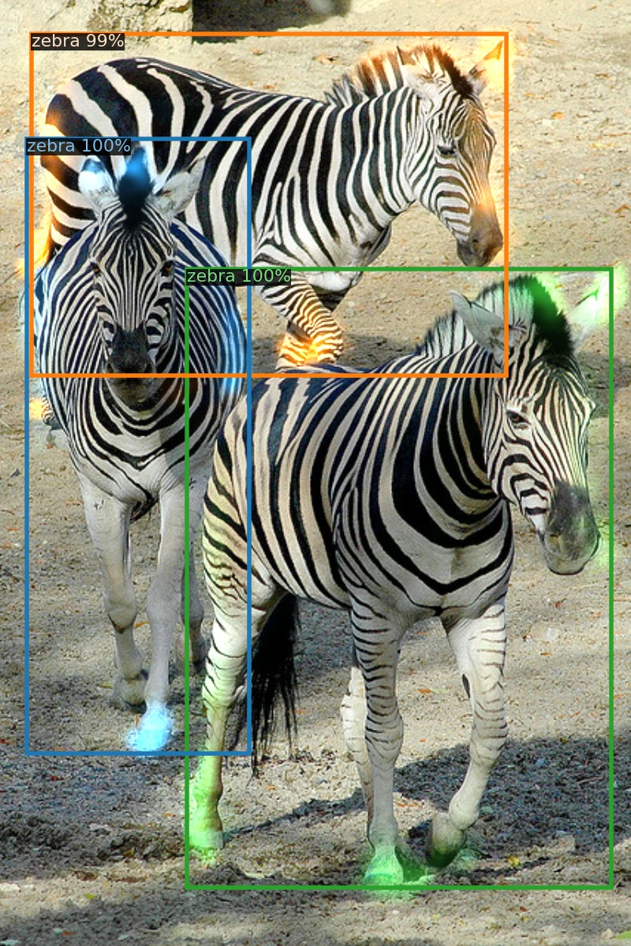
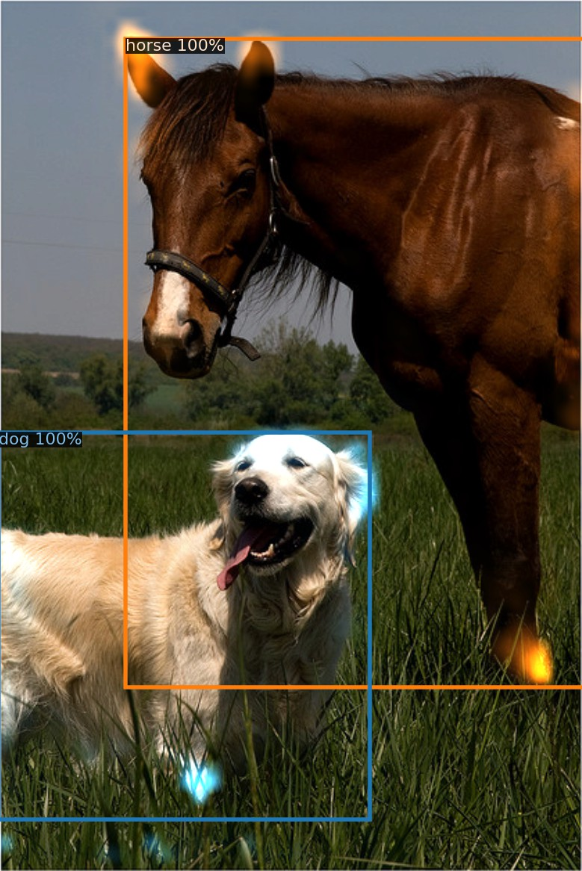
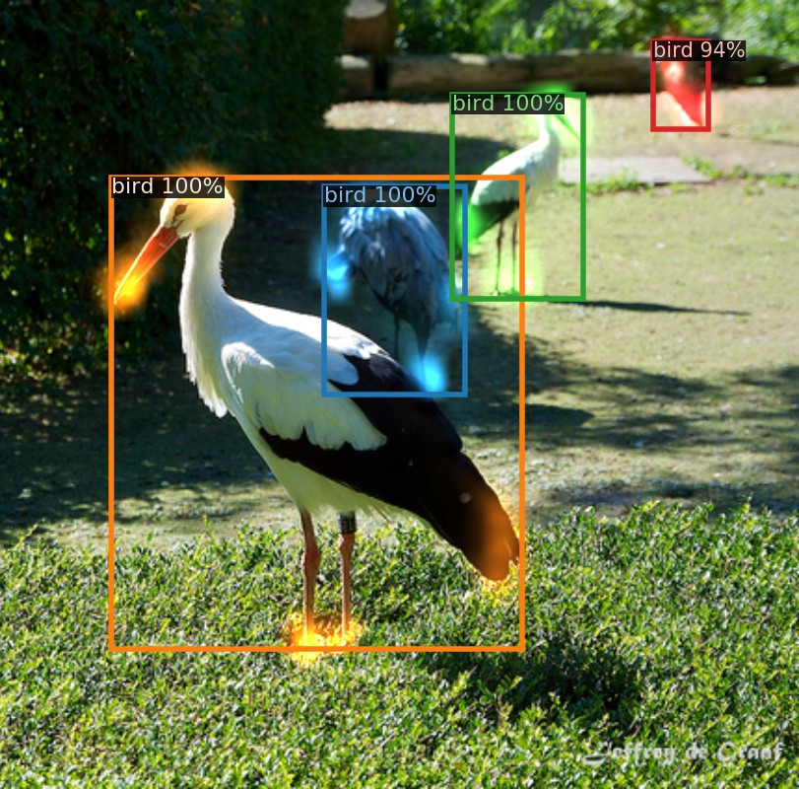
Decoder attention weights

Slide 65
Transformer architecture variations
Class
FFN
Bounding Box
FFN
Base transformer
39.2 APª
Decoder
M×
Add & Norm
FFN
Encoder
N×
Add & Norm
Add & Norm
Multi-Head Attention
V K Q
FFN
Add & Norm
Add & Norm
Multi-Head Self-Attention
V K Q
Multi-Head Self-Attention
V K Q
+
Image features
Spatial positional encoding
Object queries
ªAshish Vaswani et al. (2017). “Attention is All you Need”. In: NeurIPS.
38 / 38

Slide 66
Transformer architecture variations
Class
FFN
Bounding Box
FFN
Base transformer
39.2 APª
Decoder
M×
Add & Norm
No input positional encoding
32.8 AP
FFN
Encoder
N×
Add & Norm
Add & Norm
Multi-Head Attention
V K Q
FFN
Add & Norm
Add & Norm
Multi-Head Self-Attention
V K Q
Multi-Head Self-Attention
V K Q
Image features
Object queries
ªAshish Vaswani et al. (2017). “Attention is All you Need”. In: NeurIPS.
38 / 38

Slide 67
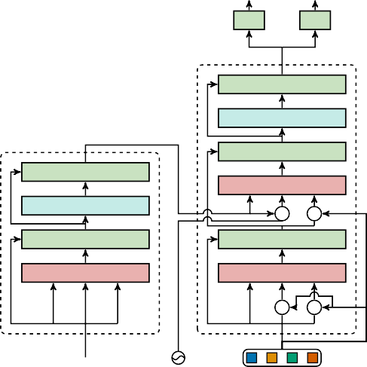
Transformer architecture variations
Class
FFN
Bounding Box
FFN
Decoder
M×
Add & Norm
FFN
Encoder
N×
Add & Norm
Add & Norm
Multi-Head Attention
FFN
V
K Q
+ +
Add & Norm
Base transformer
39.2 APª
No input positional encoding
32.8 AP
Encodings in decoder attentions only
39.3 AP
Add & Norm
Multi-Head Self-Attention
V K Q
Multi-Head Self-Attention
V
K Q
+ +
Image features
Spatial positional encoding
Object queries
ªAshish Vaswani et al. (2017). “Attention is All you Need”. In: NeurIPS.
38 / 38

Slide 68
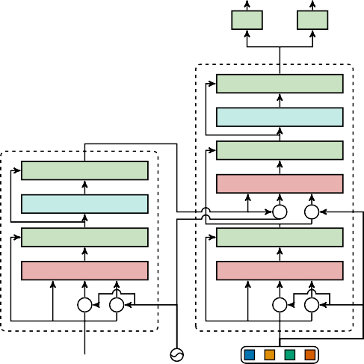
Transformer architecture variations
Class
FFN
Bounding Box
FFN
Decoder
M×
Add & Norm
FFN
Encoder
N×
Add & Norm
Add & Norm
Multi-Head Attention
FFN
V
K Q
+ +
Add & Norm
Base transformer
39.2 APª
No input positional encoding
32.8 AP
Encodings in decoder attentions only
39.3 AP
Encodings in all attentions
40.6 AP
Add & Norm
Multi-Head Self-Attention
Multi-Head Self-Attention
V
K Q
+ +
V
K Q
+ +
Image features
Spatial positional encoding
Object queries
ªAshish Vaswani et al. (2017). “Attention is All you Need”. In: NeurIPS.
38 / 38

Slide 69
Transformer architecture variations
Class
FFN
Bounding Box
FFN
Decoder
M×
Base transformer
39.2 APª
No input positional encoding
32.8 AP
Encodings in decoder attentions only
39.3 AP
Encodings in all attentions
40.6 AP
All transformer parts are contributing!
Add & Norm
FFN
Encoder
N×
Add & Norm
Add & Norm
Multi-Head Attention
FFN
V
K Q
+ +
Add & Norm
Add & Norm
Multi-Head Self-Attention
Multi-Head Self-Attention
V
K Q
+ +
V
K Q
+ +
Image features
Spatial positional encoding
Object queries
ªAshish Vaswani et al. (2017). “Attention is All you Need”. In: NeurIPS.
38 / 38

Slide 70
Transformers in Autonomous driving
Sergey Zagoruyko

Slide 71
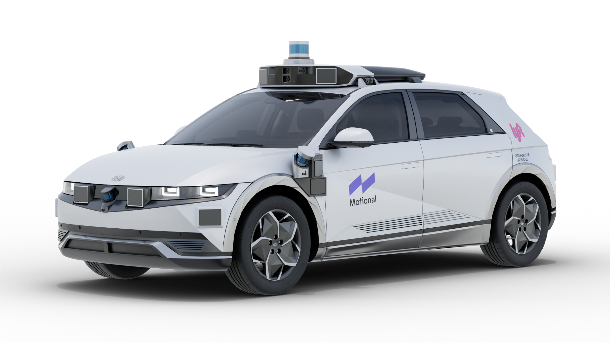
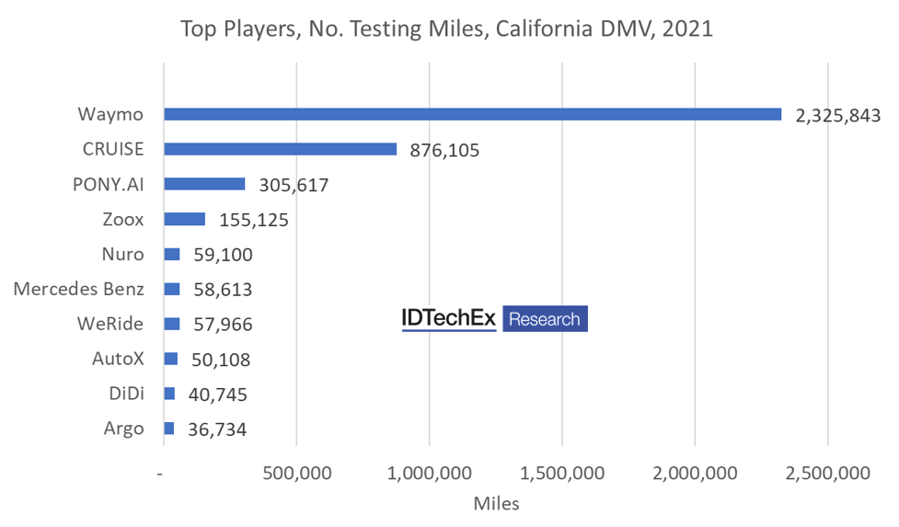
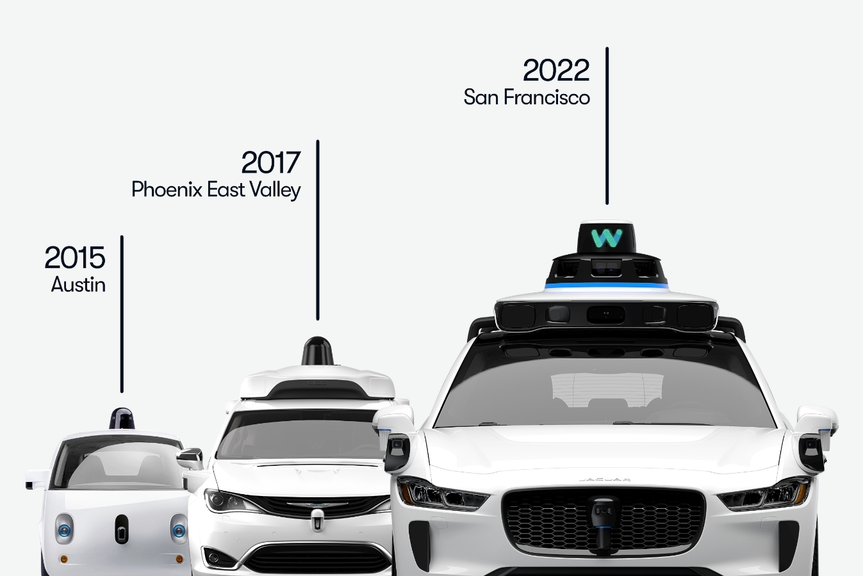
AV companies: the US

Slide 72
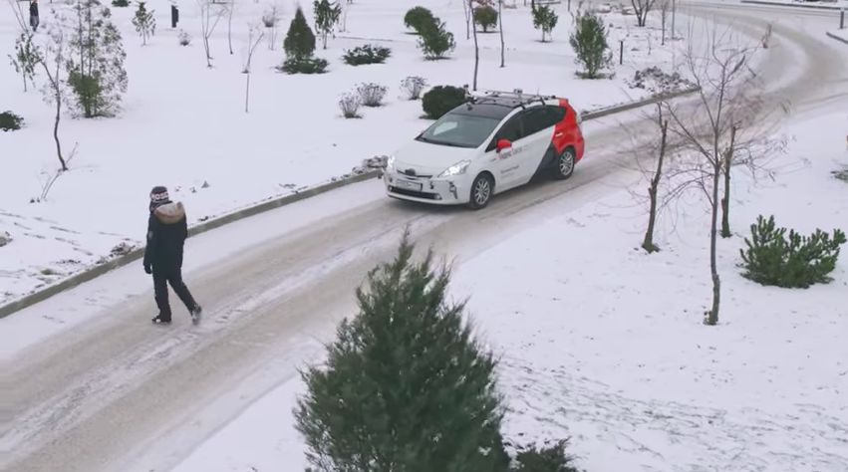
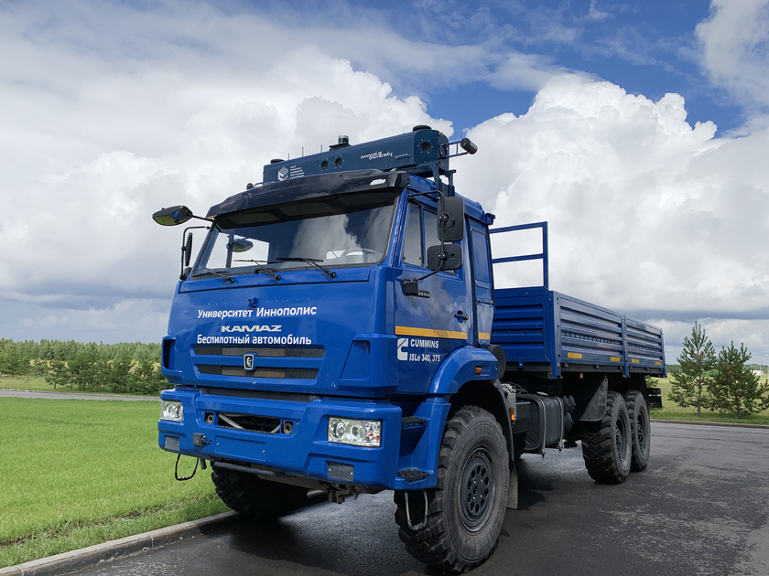
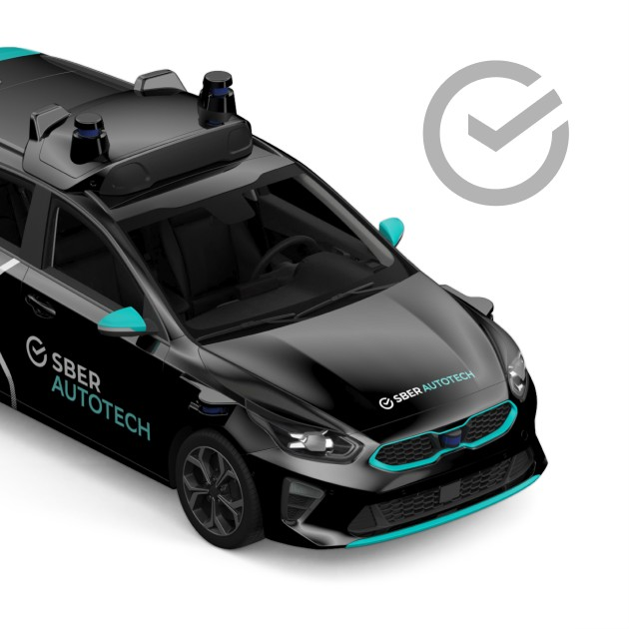
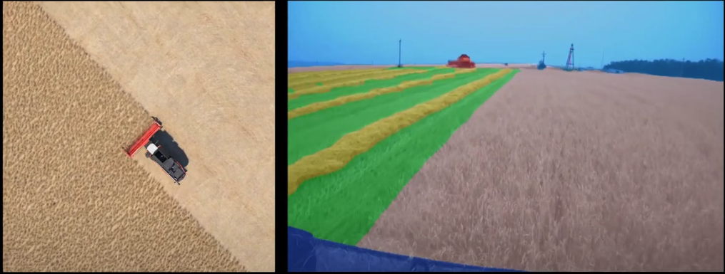
AV companies: Russia
Yandex's autonomous cars have driven over six million miles in 'challenging conditions'
https://www.youtube.com/watch?v=q-ekm7uqeq8

Slide 73
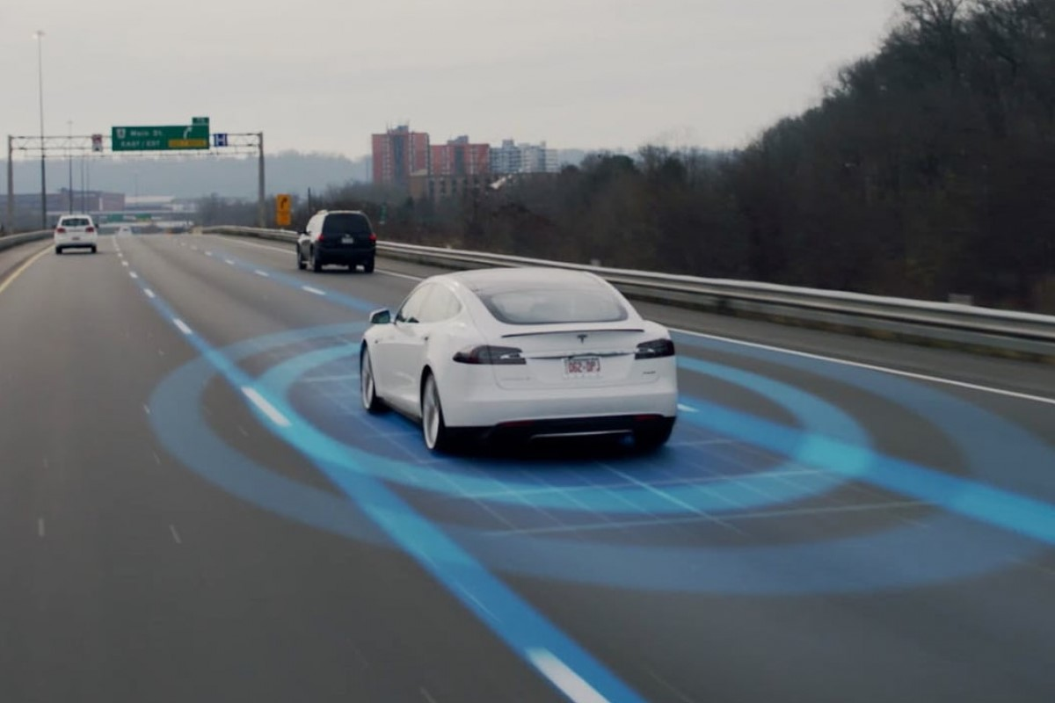
When did first autonomous vehicle was developed?
https://youtu.be/YZ6nPhUG2i0
In 1980s Ernst Dickmanns developed a system which was able to drive more than 1000 kms autonomously!

Slide 74
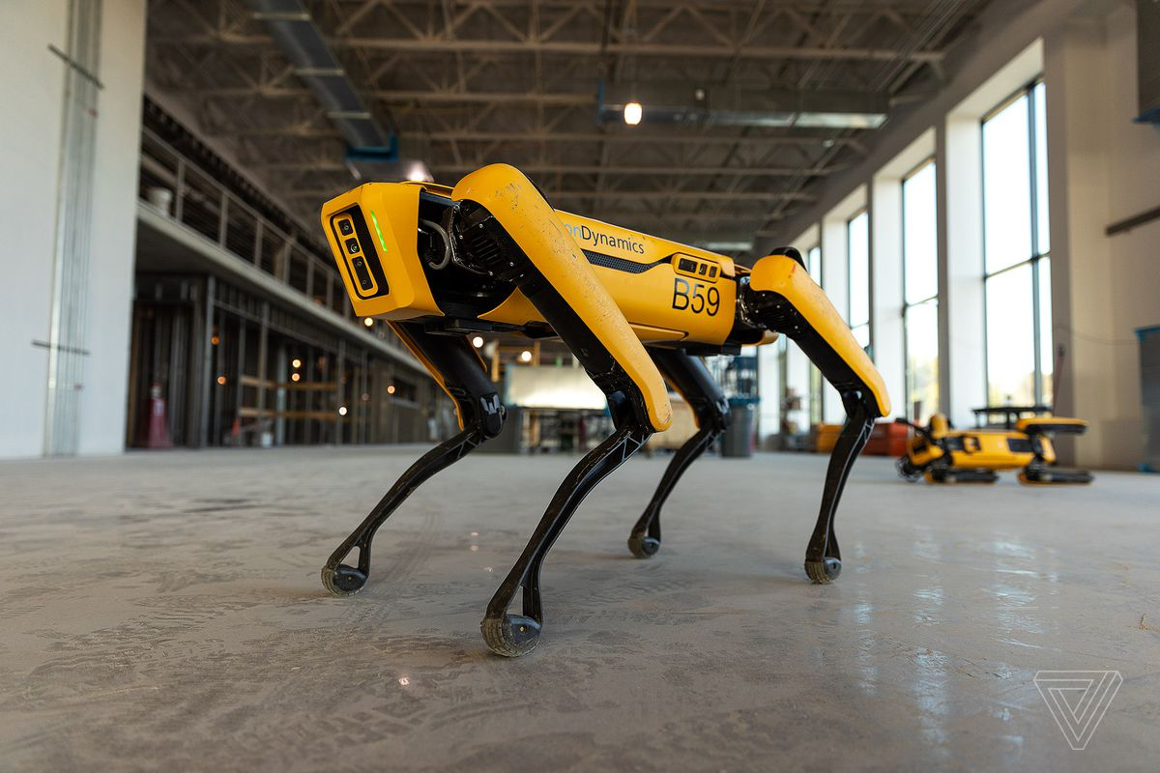
What kind of machine learning is used in robots?
None.

Slide 75
Autonomous Driving stack

Slide 82
Slide credit: Ana Ferreira and Christian Perone

Slide 84
Slide credit: Ana Ferreira and Christian Perone

Slide 85
Slide credit: Ana Ferreira and Christian Perone

Slide 86
Slide credit: Ana Ferreira and Christian Perone

Slide 87
Imitation learning

Slide 93
Does not work out of the box for AV planning
One way to make it work is to add perturbations
ChauffeurNet: Learning to Drive by Imitating the Best and Synthesizing the Worst
Mayank Bansal, Alex Krizhevsky, Abhijit Ogale

Slide 94
Transformers in Perception

Slide 95
Autonomous Driving datasets
KITTI
Waymo Open Dataset
nuScenes / nuPlan / nuImages
Lyft prediction / perception datasets
Yandex Vehicle Motion Prediction
…
Many more

Slide 96
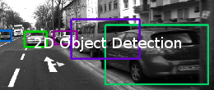
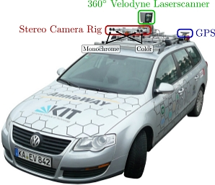
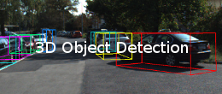
Autonomous Driving datasets
KITTI: detection

Slide 97
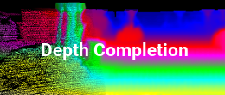
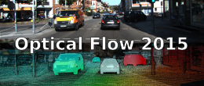
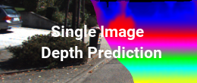
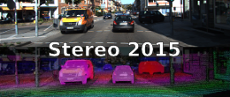
Autonomous Driving datasets
KITTI: stereo

Slide 98
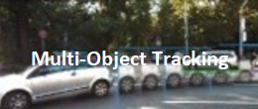
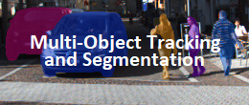
Autonomous Driving datasets
KITTI: tracking

Slide 99
Autonomous Driving datasets
KITTI: road lane detection

Slide 100
Autonomous Driving datasets
KITTI: road lane detection

Slide 101
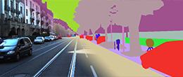
Autonomous Driving datasets
KITTI: segmentation

Slide 102
Autonomous Driving datasets
nuScenes
nuPlan
nuImages

Slide 103
HDMapNet

Slide 104
HDMapNet

Slide 105
DETR: End-to-end Object Detection
Applying NMT to translate CNN features to detections:

Slide 106
VectorMapNet and MapTR
Liu et al, VectorMapNet: End-to-end Vectorized HD Map Learning

Slide 107
PointPillars

Slide 108
End-to-end multi-camera 3D MOT
Pang et al., Standing Between Past and Future: Spatio-Temporal Modeling for Multi-Camera 3D Multi-Object Tracking

Slide 109
Perception problems
Planning and simulation uncover perception problems:
Long tail
Data collection and annotation are expensive
Offline perception is computationally heavy
Requires storing large amounts of data
Creating high-definition maps is difficult, become obsolete with time

Slide 110
Anecdotal cases: trucks
Problem for simulation and planning

Slide 111
Anecdotal cases: trucks

Slide 112
Anecdotal cases: animals

Slide 113
Transformers in Motion Planning

Slide 120
Ensuring safety

Slide 121
Notes:
2 problems: Mode switching and difficulty of creating fallback

Slide 122
SafePathNet
Pick safest trajectory according to predictions
Safe Real-World Autonomous Driving by Learning to Predict and Plan with a Mixture of Experts (Pini, 2022)

Slide 123
SafePathNet
Learns multiple futures in unsupervised way
Similar to DETR

Slide 124
SafePathNet

